Slide 1
Report
Nov-2023 MP Inspection BFX – AT100
Date : 14-Dec-2023
Prepared by: Rachel Ruan

Slide 2
Issue Description
29-Nov, ALT customer complain [BFX-AT100] Nov – 2023 Mass production issue.
Overall inspection result => Conditional Pass
Defect Total:
Defect Total
• Major
Stain of Top housing rear side * 25%
• Minor
HDMI cable cosmetic issue * 1pc

Slide 3

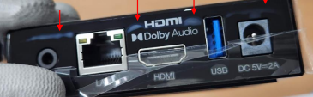

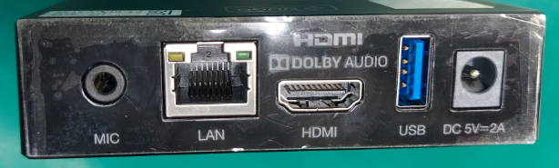
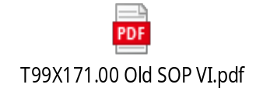

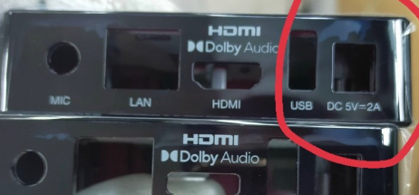
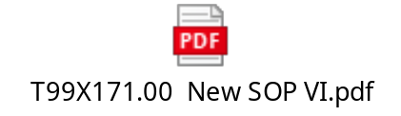
1. Stain of Top housing rear side * 25%
Issue Description | FA | Actions | Status
Symptom: Stain of Top housing rear side. Type: Major Defect unit Q’ty : 25% / 1000pcs Defect rate : 25% | 1. Fail symptom: Stain of Top housing rear side ,this stain can't be erased. 2. Fii Check FATP data → Product test pass normally, Check housing incoming no have abnormal issue. 3. Feedback to NEW vendor, they confirm no have stain issue on housing before ship to Fii factory. They will monitor this issue on production line. 4. Fii Verify at Visual inspection : Cause on Top housing at connector side have many dust sticks tightly on the housing, we clean it by wiping with a damp cloth with alcohol and over time will have stains at that area. | 1. We re-definite SOP at visual inspection station, use water ( not use alcohol ) for clean dust. Done 04-Dec-2023. 2. On production line test station, maintenance and skip clean test fixture, tray transfer and line production on time.

Slide 4
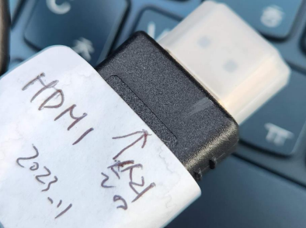
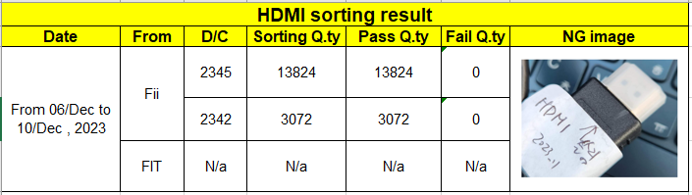
2. HDMI cable cosmetic issue * 1pcs
Issue Description | FA | Actions | Status
Symptom: HDMI cable cosmetic issue * 1pcs Type: Minor Defect unit Q’ty : 1pcs / 1000pcs Defect rate : 0.1% | Fail symptom: HDMI cable cosmetic issue ALT action: Replace normal HDMI Cable 2. Cause HDMI cable is accessory, no check cosmetic and function online product. 3. Check IQC data -> No found abnormal | 1. Add NG HDMI picture to IQC SIP. Done IQC check incoming HDMI cable follow rate: Visual inspection: AQL1.5 Function follow: AQL10.0. 2. Feedback FIT vendor, request checking all FIT stock inventory , FIT inventory is empty on Dec/2023. 3. Fii check inventory, Result no defect cosmetic issue. Done 4. Fii skip monitor this issue online production, we check accessory on OBA station notice it.

